Slide 1
Spring MVC

Slide 2
Table of Contents

Slide 3
Dispatcher Servlet
The central component of Spring MVC is DispatcherServlet.
It acts as the front controller of the Spring MVC framework, and every web request must go through it so that it can manage the entire request-handling process.

Slide 4
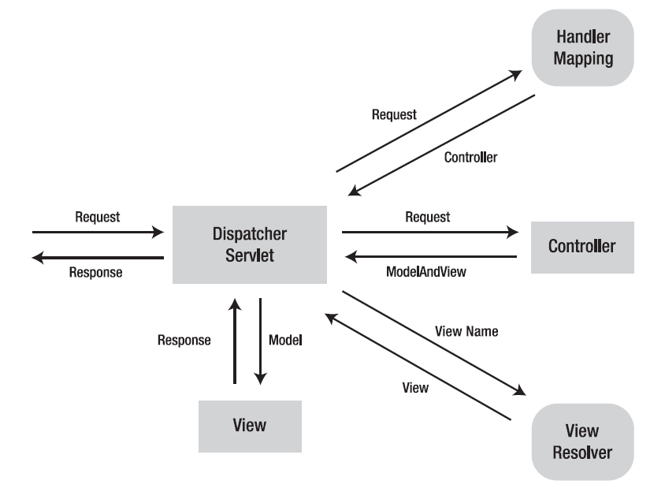
Flow of Request

Slide 5
Handler Mapping
A handler mapping is a bean configured in the web application context that implements the HandlerMapping interface. It is responsible for returning an appropriate handler for a request.
Handler mappings usually map a request to a handler according to the request’s URL.
A handler is an arbitrary Java object that can handle web requests.
The most typical handler used in Spring MVC for handling web requests is a controller.

Slide 6
ModelAndView
After a controller has finished handling the request, it returns a model and a view name, or sometimes a view object, to DispatcherServlet.
The model contains the attributes that the controller wants to pass to the view for display.
If a view name is returned, it will be resolved into a view object for rendering. The basic class that binds a model and a view is ModelAndView.

Slide 7
ViewResolver
When DispatcherServlet receives a model and a view name, it will resolve the logical view name into a view object for rendering.
DispatcherServlet resolves views from one or more view resolvers.
A view resolver is a bean configured in the web application context that implements the ViewResolver interface. Its responsibility is to return a view object for a logical view name.

Slide 8
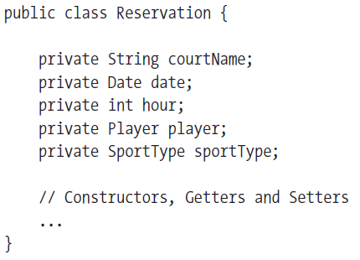
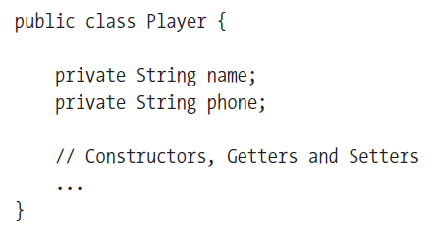
Example
We are going to develop a court reservation system for a sports center. Following are the classes in our application :

Slide 9

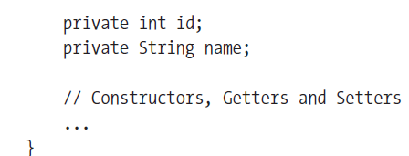
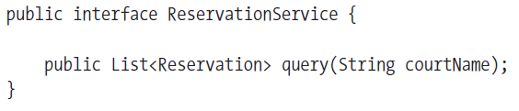

Slide 10
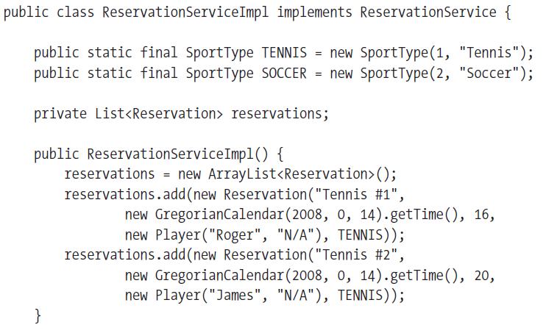

Slide 11
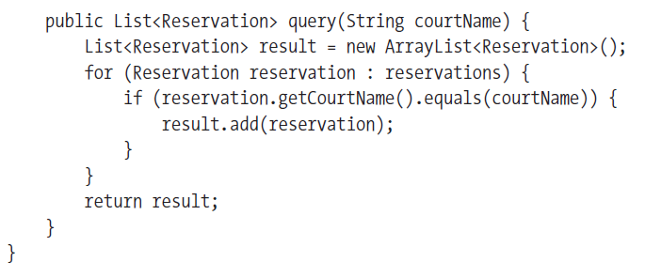

Slide 12
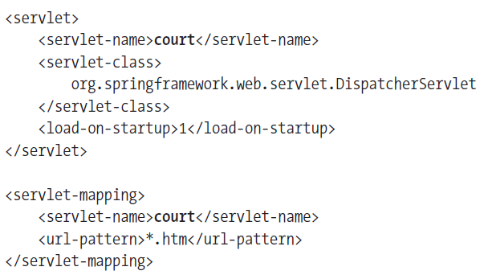
Setting Up a Spring MVC Application
Configure the following Servlet in web.xml
The <servlet-name> given to the servlet is significant. By default, when DispatcherServlet is loaded, it will load the Spring application context from an XML file whose name is based on the name of the servlet. In this case, because the servlet is named court, DispatcherServlet will try to load the ApplicationContext from a file named court-servlet.xml.

Slide 13
Breaking up the application context
It is recommend that you split your application context across application layers in to different xml configuration files.
To ensure that all of these configuration files are loaded, you’ll need to configure a context loader in your web.xml file
A context loader loads context configuration files in addition to the one that DispatcherServlet loads. The most commonly used context loader is a servlet listener called ContextLoaderListener that is configured in web.xml as follows
  <listener>
  <listener-class> org.springframework.web.context.ContextLoaderListener
  </listener-class>
  </listener>

Slide 14
Breaking up the application context
With ContextLoaderListener configured, you’ll need to tell it the location of the Spring configuration file(s) to load. If not specified otherwise, the context loader will look for a Spring configuration file at /WEB-INF/applicationContext.xml.
You can specify one or more Spring configuration files for the context loader to load by setting the contextConfigLocation parameter in the servlet context:
  < context- param >
  < param-name>contextConfigLocation</ param-name>
    < param-value>
    /WEB-INF/court-service.xml
    /WEB-INF/court-data.xml
    /WEB-INF/court-security.xml
    </ param-value>
  </ context-param>

Slide 15
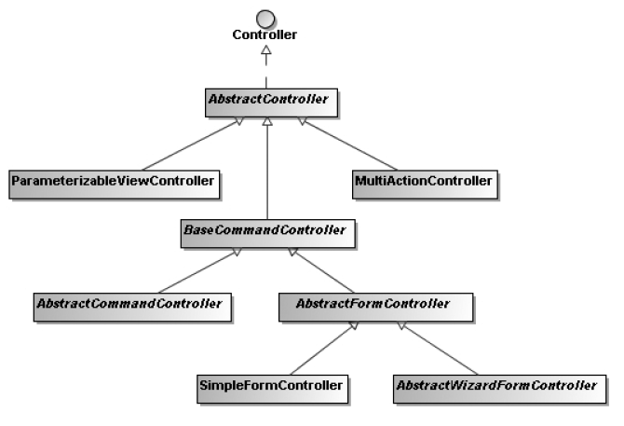
Spring MVC Controllers

Slide 16
The Controller interface is the base interface for all the controller classes in Spring MVC.
You can create your own controller by implementing this interface. In the handleRequest() method, you are free to handle a web request just as you do in a servlet.
Finally, you have to return a ModelAndView object that includes a view name or a view object, and some model attributes.
For example, you can create a welcome controller for your court reservation system as follows.

Slide 17
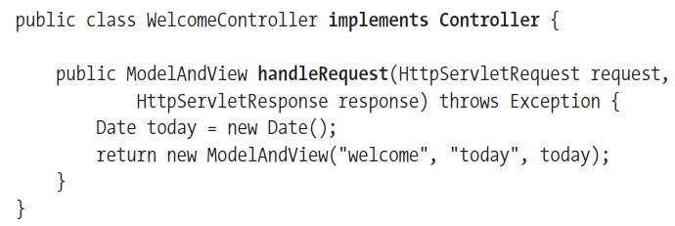
Implementing Controller
After you create a controller class, you have to declare its instance in the web application context
<bean name="/welcome.htm"
class="com.training.court.web.WelcomeController" />
By default, DispatcherServlet uses BeanNameUrlHandlerMapping as its default handler mapping
This handler mapping maps requests to handlers according to the URL patterns specified in the bean names of the handlers.

Slide 18
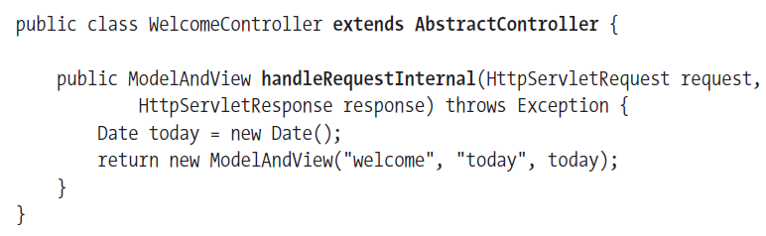
Implementing AbstractController
If you would like your controller to have some basic controller features like filtering the supported HTTP methods (GET, POST, and HEAD) and generating the cache-control header in HTTP responses, you can have it extend the AbstractController class, which implements the
Controller interface.
Note that the method you have to override in this controller class is handleRequestInternal().
..Continued

Slide 19
<bean name="/welcome.htm“ class="com.training.court.web.WelcomeController">
<property name="supportedMethods" value="GET" />
<property name="cacheSeconds" value="60" />
</bean>
If an HTTP request’s method is not in this list, a ServletException will be thrown.
You can also define the cache seconds for a controller so that it will be set in an HTTP response’s header.

Slide 20
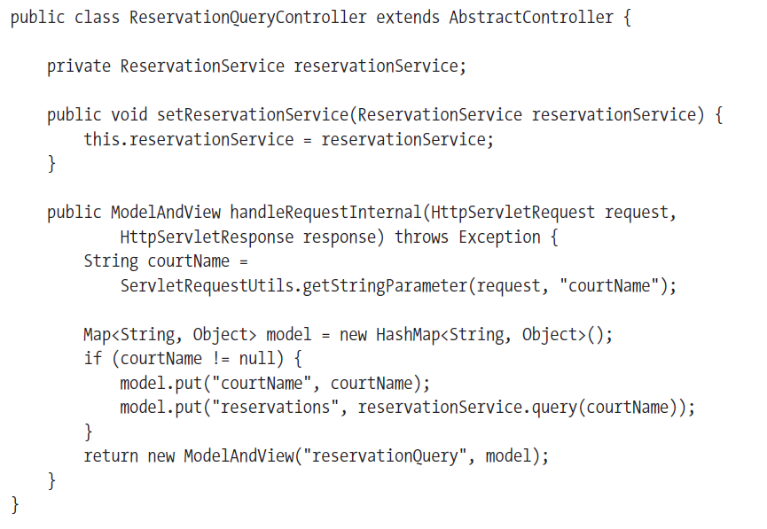
Another implementation of AbstractController
..Continued

Slide 21
When you have more than one model attribute to pass to the view, you can store them in a map and pass this map to the constructor of ModelAndView.
<bean name="/reservationQuery.htm“ class="com.training.court.web.ReservationQueryController">
<property name="reservationService" ref="reservationService" />
</bean>

Slide 22
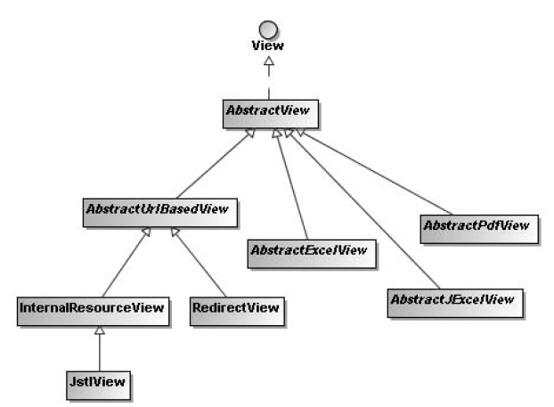
View

Slide 23
Configuring ViewResolver
When DispatcherServlet receives a view name returned from a handler, it will resolve the logical view name into a view object for rendering.
For example, you can configure an InternalResourceViewResolver bean in the web application context to resolve view names
into JSP files in the /WEB-INF/jsp/ directory:
<bean class="org.springframework.web.servlet.view.InternalResourceViewResolver">
<property name="prefix" value="/WEB-INF/jsp/" />
<property name="suffix" value=".jsp" />
</bean>

Slide 24
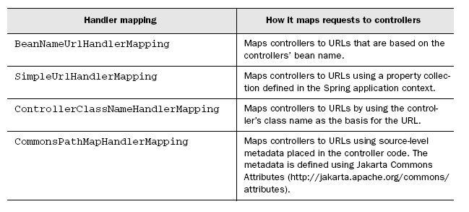
Mapping Requests to Controllers
Handler mappings are used to map requests to controllers .
All of Spring MVC’s handler mappings implement the org.springframework.web.servlet.HandlerMapping interface.
Spring comes prepackaged with four useful implementations of HandlerMapping, as listed below :

Slide 25
Using SimpleUrlHandlerMapping
SimpleUrlHandlerMapping lets you map URL patterns directly to controllers without having to name your beans in a special way.
Consider the following example :
  <bean id="simpleUrlMapping" class=
  "org.springframework.web.servlet.handler.SimpleUrlHandlerMapping">
    <property name="mappings">
    <props>
    <prop key="/home.htm">homePageController</prop>
    <prop key="/displayEmployess.htm“> displayEmployeeController</prop>
    <prop key="/login.htm">loginController</prop>
    <prop key="/register.htm">registerController</prop>
    <prop key="/addEmployee.htm">addEmployeeController</prop>
    </props>
    </property>
  </bean>

Slide 26
Using ControllerClassNameHandlerMapping
By configuring ControllerClassNameHandlerMapping, you are telling Spring’s DispatcherServlet to map URL patterns to controllers following a simple convention.
Instead of explicitly mapping each controller to a URL pattern, Spring will automatically map controllers to URL patterns that are based on the controller’s class name.
Put simply, to produce the URL pattern, the Controller portion of the controller’s class name is removed (if it exists), the remaining text is lowercased, a slash (/) is added to the beginning, and ".htm" is added to the end to produce the URL pattern.
For example , com.springmvc.controller.DisplayEmployeeController is mapped to URL displayemployee.htm .
Configure a bean as follows :
  <bean id="urlMapping"
  class="org.springframework.web.servlet.mvc.ControllerClassNameHandlerMapping"/>

Slide 27
Some Examples :
WelcomeController → /welcome*
ReservationQueryController→ /reservationquery*
if you want your URL patterns to follow the variable-naming convention in Java (e.g., generating /reservationQuery* instead of reservationquery*), you have to set the caseSensitive property to true
you can specify a prefix for the generated URL patterns
in the pathPrefix property. You can also specify the base package in the basePackage property, and then the subpackage relative to it will be included in the mapping.
…Continued

Slide 28
<bean class="org.springframework.web.servlet.mvc.support.
ControllerClassNameHandlerMapping">
<property name="caseSensitive" value="true" />
<property name="pathPrefix" value="/reservation" />
<property name="basePackage" value="com.trainingspringrecipes.court" />
</bean>
This ControllerClassNameHandlerMapping definition will generate the following handler
mappings:
WelcomeController →/reservation/web/welcome*
ReservationQueryController → /reservation/web/reservationQuery*

Slide 29
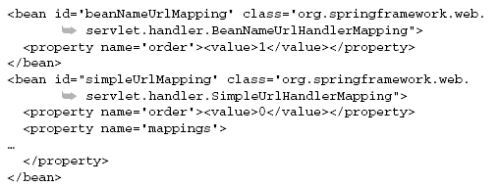
Working with multiple handler mappings
All of the handler mapping classes implement Spring’s Ordered interface. This means that you can declare multiple handler mappings in your application and set their order properties to indicate which has precedence with relation to the others.
For example, suppose you want to use both BeanNameUrlHandlerMapping and SimpleUrlHandlerMapping alongside each other in the same application. We need to declare the handler mapping beans as follows:

Slide 30
Intercepting Requests with Handler Interceptors
Just like Servlet filters .
Spring MVC allows you to intercept web requests for pre-handling and post-handling through handler interceptors
A handler interceptor is registered for particular handler mappings, so it will only intercept requests mapped by these handler mappings.
Each handler interceptor must implement the HandlerInterceptor interface, which contains three callback methods for you to implement: preHandle(), postHandle(), and afterCompletion().
afterCompletion() method will be called after the completion of all request processing (i.e., after the view has been rendered).

Slide 31
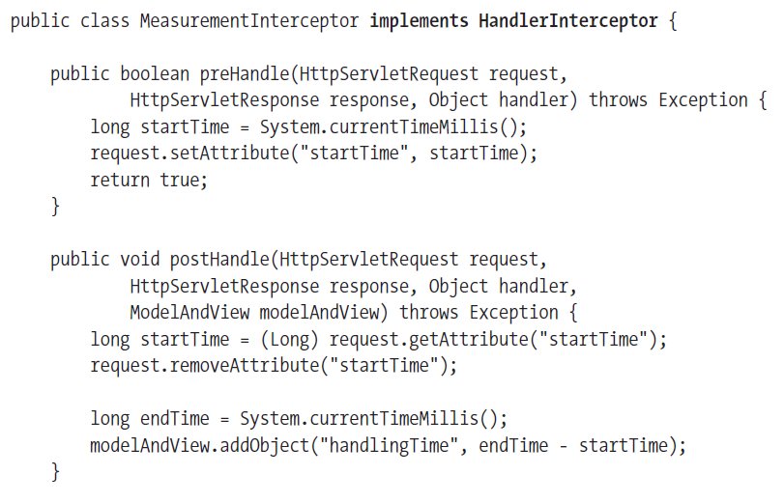

Slide 32
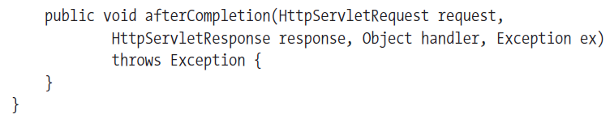
preHandle ()method should return true, allowing DispatcherServlet to proceed. with request handling. Otherwise, DispatcherServlet assumes that this method has already handled the request, so DispatcherServlet will return the response to the user directly.
A handler interceptor is registered to a handler mapping bean to intercept web requests mapped by this bean. You can specify multiple interceptors for a handler mapping in the interceptors property, whose type is an array.

Slide 33
Configuring Handler Interceptors
<bean id="measurementInterceptor"
class="com.training.court.web.MeasurementInterceptor" />
<bean class="org.springframework.web.servlet.handler.SimpleUrlHandlerMapping">
<property name="interceptors">
<list>
<ref bean="measurementInterceptor" />
</list>
</property>
</bean>
<bean class="org.springframework.web.servlet.mvc.support.
ControllerClassNameHandlerMapping">
<property name="interceptors">
<list>
<ref bean="measurementInterceptor" />
</list>
</property>
</bean>

Slide 34
Resolving User Locales
In order for your web application to support internationalization, you have to identify each user’s preferred locale and display contents according to this locale.
A user’s locale is identified by a locale resolver, which has to
implement the LocaleResolver interface.
You can define a locale resolver simply by registering a bean of type LocaleResolver in the web application context. You must set the bean name of the locale resolver to localeResolver for DispatcherServlet to auto-detect.

Slide 35
Resolving Locales by an HTTP Request Header
The default locale resolver used by Spring is AcceptHeaderLocaleResolver. It resolves locales by inspecting the accept-language header of an HTTP request.

Slide 36
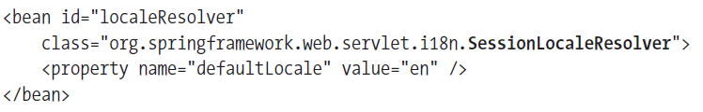
Resolving Locales by a Session Attribute
SessionLocaleResolver resolves locales by inspecting a predefined attribute in a user’s session. Attribute name is SessionLocaleResolver. LOCALE_SESSION_ATTRIBUTE_NAME
If the session attribute doesn’t exist, this locale resolver will determine the default locale from the accept-language HTTP header.

Slide 37
Resolving Locales by a Cookie
You can also use CookieLocaleResolver to resolve locales by inspecting a cookie in a user’s browser. If the cookie doesn’t exist, this locale resolver will determine the default locale from the accept-language HTTP header.
<bean id="localeResolver"
class="org.springframework.web.servlet.i18n.CookieLocaleResolver" />

Slide 38
Changing a User’s Locale
In addition to changing a user’s locale by calling LocaleResolver.setLocale() explicitly, you can also apply LocaleChangeInterceptor to your handler mappings.
This interceptor will detect if a special parameter is present in the current HTTP request. The parameter name can be customized with the paramName property of this interceptor.
If such a parameter is present in the current request, this interceptor will change the user’s locale according to the parameter value.
See next slide for configuration ……

Slide 39
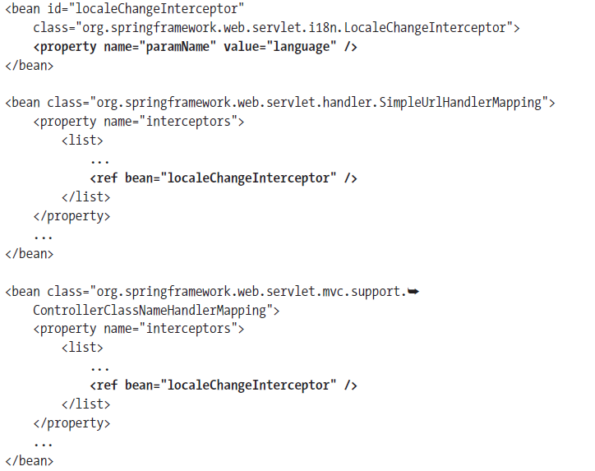

Slide 40
Internationalization
You can define a message source simply by registering a bean of type MessageSource in the web application context. You must set the bean name of the message source to messageSource for DispatcherServlet to auto-detect.
You can register only one message source per DispatcherServlet.
<bean id="messageSource"
class="org.springframework.context.support.ResourceBundleMessageSource">
<property name="basename" value="messages" />
</bean>
Then you create two resource bundles, messages.properties and messages_de.
properties, to store messages for the default and German locales. These resource bundles should be put in the root of the classpath.
welcome.title=Welcome
welcome.message=Welcome to Court Reservation System
welcome.title=Willkommen
welcome.message=Willkommen zum Spielplatz-Reservierungssystem

Slide 41
Now, in a JSP file , you can use the <spring:message> tag to resolve a message given the code. This tag will automatically resolve the message according to a user’s current locale.
<spring:message code="welcome.title“ text="Welcome" />
<spring:message code="welcome.message“ text="Welcome to Court Reservation System" />

Slide 42
Resolving Views by Names
Views are resolved by one or more view resolver beans declared
in the web application context. These beans have to implement the ViewResolver interface for DispatcherServlet to auto-detect them .

Slide 43
Resolving Views from an XML Configuration File
You can declare the view beans in the same configuration file as the web application context, but it would be better to isolate them in a separate configuration file. By default, XmlViewResolver loads view beans from /WEB-INF/views.xml, but this location can be overridden through the location property.
<bean class="org.springframework.web.servlet.view.XmlViewResolver">
<property name="location">
<value>/WEB-INF/court-views.xml</value>
</property>
</bean>

Slide 44
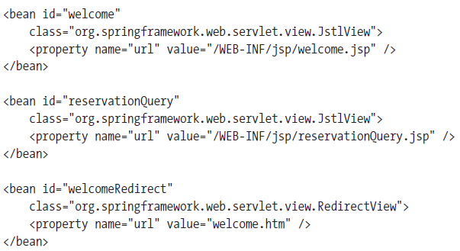
In the court-views.xml configuration file, you can declare each view as a normal Spring bean by setting the class name and properties. In this way, you can declare any types of views (e.g., RedirectView and even custom view types).

Slide 45
Resolving Views from a Resource Bundle
<bean class="org.springframework.web.servlet.view.ResourceBundleViewResolver">
<property name="basename" value="views" />
</bean>
ResourceBundleViewResolver can also take advantage of the resource bundle capability to load view beans from different resource bundles for different locales.
welcome.(class)=org.springframework.web.servlet.view.JstlView
welcome.url=/WEB-INF/jsp/welcome.jsp
reservationQuery.(class)=org.springframework.web.servlet.view.JstlView
reservationQuery.url=/WEB-INF/jsp/reservationQuery.jsp
welcomeRedirect.(class)=org.springframework.web.servlet.view.RedirectView
welcomeRedirect.url=welcome.htm

Slide 46
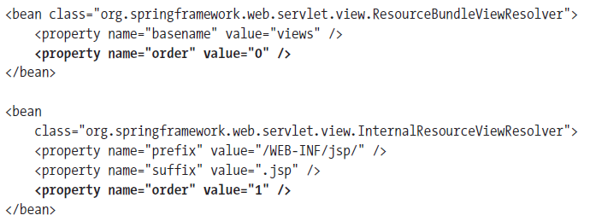
Resolving Views with Multiple Resolvers

Slide 47
The Redirect Prefix
If you have InternalResourceViewResolver configured in your web application context, it can resolve redirect views by using the redirect prefix in the view name. Then the rest of the view name will be treated as the redirect URL.
For example, the view name redirect:welcome.htm will trigger a redirect to the relative URL welcome.htm.

Slide 48
Mapping Exceptions to Views
In a Spring MVC application, you can register one or more exception resolver beans in the web application context to resolve uncaught exceptions.
These beans have to implement the HandlerExceptionResolver interface for DispatcherServlet to auto-detect them
<bean class="org.springframework.web.servlet.handler.SimpleMappingExceptionResolver">
<property name="exceptionMappings">
<props>
<prop key="com.training.court.service. ReservationNotAvailableException">
reservationNotAvailable
</prop>
<prop key="java.lang.Exception">error</prop>
</props>
</property>
</bean>

Slide 49
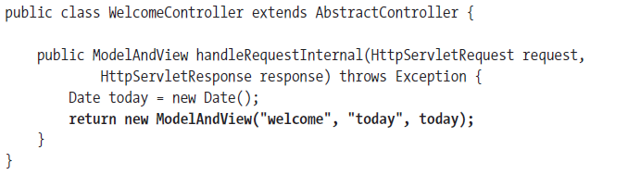
Constructing ModelAndView Objects
When you have a single model attribute to return, you can simply construct a ModelAndView object by specifying the attribute in the constructor

Slide 50
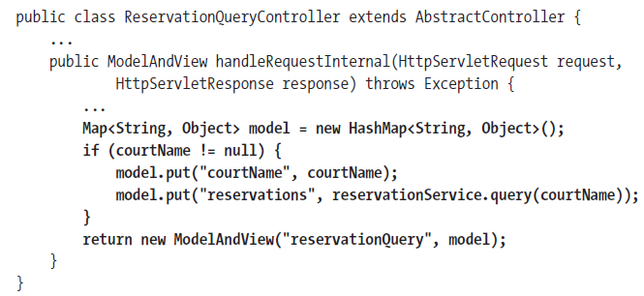
If there’s more than one attribute to return, you can construct a ModelAndView object by passing in a map:

Slide 51
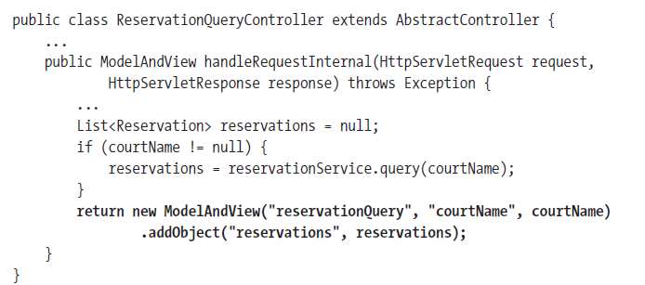
After you construct a ModelAndView object, you can still add model attributes to it using the addObject() method. This method returns the ModelAndView object itself so that you can construct a ModelAndView object in one statement.

Slide 52
Creating a Controller with a Parameterized View
When creating a controller, you don’t want to hard-code the view name in the controller class. Instead, you would like the view name to be parameterized so that you can specify it in the bean configuration file.
You can use this controller class directly for a controller that only renders a view to users without any processing logic, or you can extend this controller class to inherit the viewName property.
ParameterizableViewController is a subclass of AbstractController that defines a viewName property .
This is same as ForwardAction in Struts.

Slide 53
For example, suppose you have a very simple controller whose purpose is only to render the about view. You can declare a controller of type ParameterizableViewController and specify the viewName property as about
<bean id="aboutController"
class="org.springframework.web.servlet.mvc.ParameterizableViewController">
<property name="viewName" value="about" />
</bean>

Slide 54
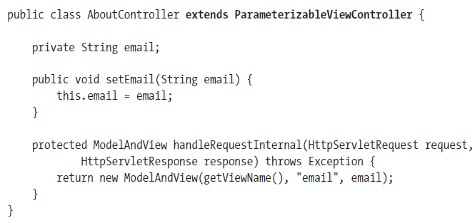
If you would like to add some processing logic to your controller while preserving the parameterized view, your controller class can extend ParameterizableViewController. The following AboutController accepts an email property and includes it in the model:
<bean id="aboutController“ class="com.training.court.web.AboutController">
<property name="viewName" value="about" />
<property name="email" value="reservation@court.com" />
</bean>

Slide 55
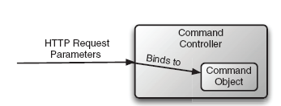
Command Controllers
We can use AbstractController when we don’t need to bind request parameters to business objects
Even when we need to bind request parameters to business objects, we can use AbstractController . But we have to write all the logic .
In the event that your controller will need to perform work based on parameters, your controller class should extend a command controller class such as AbstractCommandController.
Command controllers relieve you from the hassle of dealing with request parameters directly.
They bind the request parameters to a command object that you’ll work with instead.

Slide 56
Example
public class AddEmployeeController extends AbstractCommandController{
EmployeeDao employeeDao;
public EmployeeDao getEmployeeDao() {
return employeeDao;
}
public void setEmployeeDao(EmployeeDao employeeDao) {
this.employeeDao = employeeDao;
}
protected ModelAndView handle(HttpServletRequest request, HttpServletResponse response, Object command, BindException errors) throws Exception {
Employee employee=(Employee)command;
employeeDao.addEmployee(employee);
return new ModelAndView("displaySuccess","employee",employee);
}
}

Slide 57
<bean name="/addEmployee.htm" class="com.mvcapp.AddEmployeeController">
<property name="commandClass" value="com.mvcapp.Employee" />
<property name="commandName" value="employee" />
<property name="employeeDao" ref="employeeDao" />
</bean>

Slide 58
SimpleFormController
The SimpleFormController class provided by Spring MVC defines the basic form-handling flow.
It supports the concept of a command object and can bind form field values to a command object’s properties of the same name.
When SimpleFormController is asked to show a form by an HTTP GET request, it will render the form view to the user.
When the form is submitted by an HTTP POST request,
SimpleFormController will handle the form submission by binding the form field values to a command object and invoking the onSubmit() method

Slide 59
If the form is handled successfully, it will render the success view to the user. Otherwise, it will render the form view again with the
errors.

Slide 60
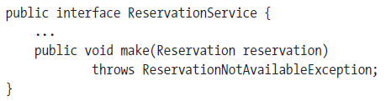
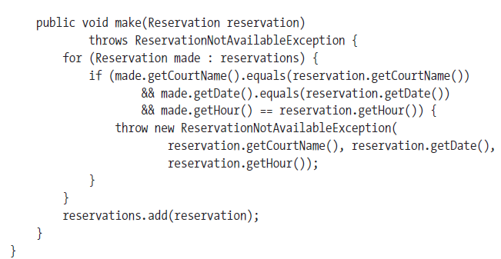
Example
Suppose you would like to allow a user to make a court reservation by filling out a form.

Slide 61
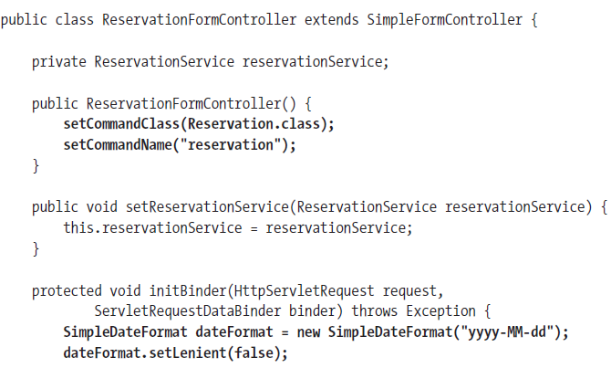
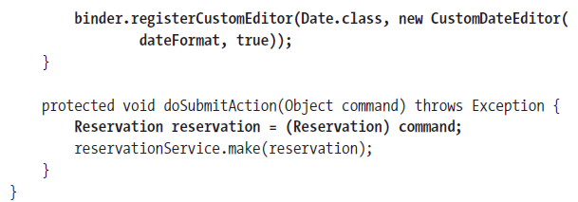
Creating a Form Controller

Slide 62
initBinder
To bind form field values to a command object, a form controller may have to perform type conversions for the field values, as they are all submitted as strings.
The type conversions are actually performed by property editors registered in this controller. Spring has preregistered several property editors to convert well-known data types such as numbers and
Booleans. You have to register your custom editors for other data types such as java.util.Date.
Custom property editors are registered to the ServletRequestDataBinder argument in the initBinder() method.

Slide 63
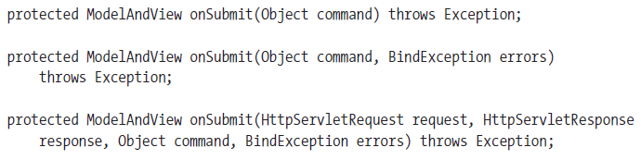
If there’s anything wrong when binding the form field values, SimpleFormController will automatically render the form view again with the errors.
Otherwise, it will call the onSubmit() method to handle the form submission
There are three variants of the onSubmit() method that you can override. You should override the simplest of them to get access to the method arguments that meet your needs.

Slide 64
When overriding an onSubmit() method, you have to return a ModelAndView object.
If you only need to perform an action on the command object and return the success view when this action completes, you can override the doSubmitAction() method instead, whose return type is void, and which will render the success view by default.
<bean id="reservationFormController“ class="com.training.court.web.ReservationFormController">
<property name="reservationService" ref="reservationService" />
<property name="formView" value="reservationForm" />
<property name="successView" value="reservationSuccess" />
</bean>

Slide 65
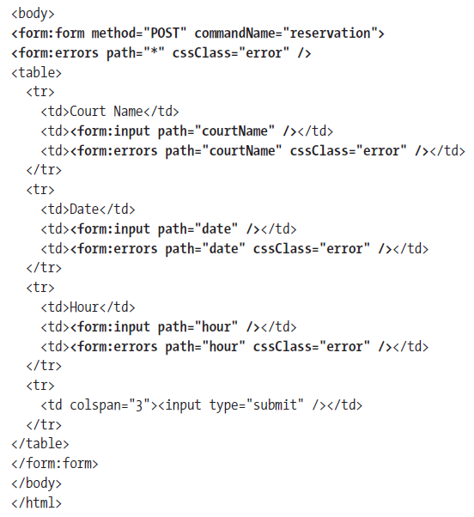
reservationForm.jsp

Slide 66
The <form:input> and <form:select> tags can bind to a property path of the command object by specifying the path attribute.
They will show the user the original value of the field, which is either the bound property value or the value rejected due to binding error.
They must be used inside the <form:form> tag, which defines a form and binds to the command object by its name.
If you don’t specify the command object’s name, then the default name command will be used.

Slide 67
In the form field–binding process, errors may occur due to invalid values.
For example, if the date is not in a valid format as specified in CustomDateEditor, the preceding form controller won’t be able to convert these fields.
This controller will generate a list of selective error codes for each error. For an invalid value input in the date field, the following error codes will be generated:
typeMismatch.command.date
typeMismatch.date
typeMismatch.java.util.Date
typeMismatch

Slide 68
If you have ResourceBundleMessageSource defined, you can include the following error messages in your resource bundle for the appropriate locale
typeMismatch.date=Invalid date format
typeMismatch.hour=Invalid hour format

Slide 69
Applying the Post/Redirect/Get Design Pattern
When you refresh the web page in the form success view, the form you just submitted will be resubmitted again. This problem is known as duplicate form submission.
To avoid this problem, you can apply the post/redirect/get design pattern, which recommends redirecting to another URL after a form submission is handled successfully, instead of returning an HTML page directly.
Consider following controller declaration :
<bean id="reservationFormController"
class="com.training.court.web.ReservationFormController">
<property name="reservationService" ref="reservationService" />
<property name="formView" value="reservationForm" />
<property name="successView" value="reservationSuccessRedirect" />
</bean>

Slide 70
As you have ResourceBundleViewResolver configured in your web application context, you can define the following redirect view in views.properties in the classpath root:
reservationSuccessRedirect.(class)=org.springframework.web.servlet.view.RedirectView
reservationSuccessRedirect.url=reservationSuccess.htm
U can configure as follows :
<bean class="org.springframework.web.servlet.handler.SimpleUrlHandlerMapping">
……….
<property name="mappings">
<props>
...
<prop key="/reservationSuccess.htm">reservationSuccessController</prop>
</props>
</property>
</bean>

Slide 71
<bean id="reservationSuccessController"
class="org.springframework.web.servlet.mvc.ParameterizableViewController">
<property name="viewName" value="reservationSuccess" />
</bean>
U can simply configure the same redirect view as follows :
<bean id="reservationFormController"
class="com.training.court.web.ReservationFormController">
<property name="reservationService" ref="reservationService" />
<property name="formView" value="reservationForm" />
<property name="successView" value=“redirect:reservationSuccess" />
</bean>

Slide 72
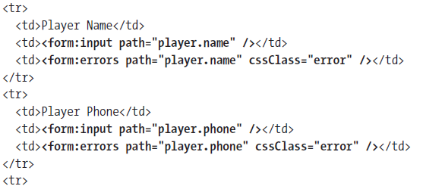
Initializing the Command Object
in some cases you may have to initialize the command
object by yourself. For example, let’s consider a situation where you are going to bind a player’s name and phone to a Reservation object’s player property:
However, when the command class Reservation has just been instantiated, the player property is null, so it will cause an exception when rendering this form.

Slide 73
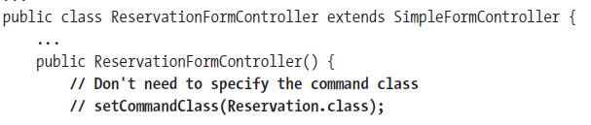
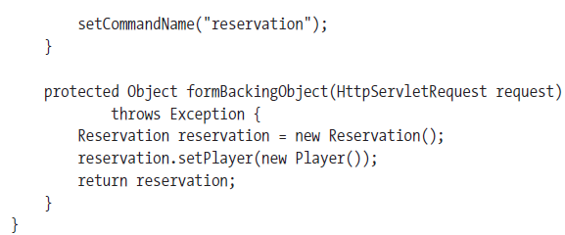
To solve this problem, you have to initialize the command object by yourself. You can override the formBackingObject() method of SimpleFormController for this purpose.

Slide 74
bindOnNewForm
The bindOnNewForm property sets whether the request parameters should be bound to the command object when creating a new form.
If bindOnNewForm is set to true, the request parameters will be bound to the properties of the same name.
U can test with following URL
http://localhost:8080/court/reservationForm.htm?date=2008-01-14

Slide 75
sessionForm
sessionForm, sets whether the command object should be stored in
the session.
By default, this is false so that a new command object will be created on each request, even when rendering the form again due to binding errors.
If this property is set to true, the command object will be stored in the session for subsequent uses, until the form completes successfully. Then this command object will be cleared from the session.

Slide 76

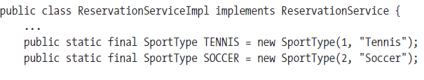
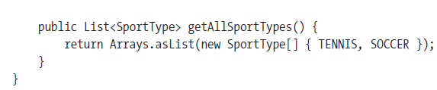
Providing Form Reference Data
When a form controller is requested to render the form view, it may have some types of reference data to provide to the form (e.g., the items to display in an HTML selection). Now suppose you would like to allow a user to select the sport type when reserving a court.

Slide 77
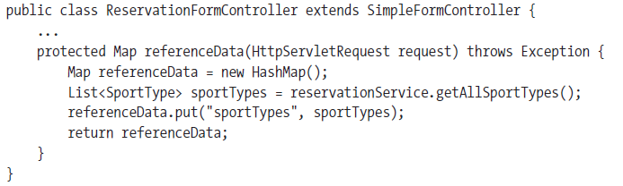

You should put the reference data in a map and return it for this method. This map will be added to the model and passed to the form view automatically.
In JSP, U can use the following code to display the reference Data

Slide 78
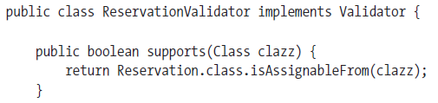
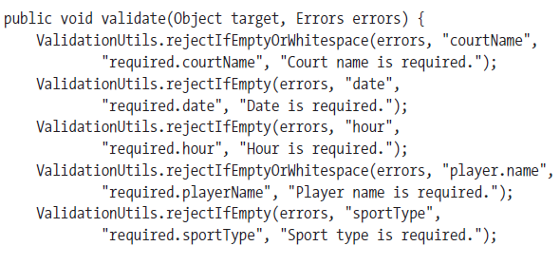
Validating Form Data
SimpleFormController can help you to validate the command object after it binds the form field values. The validation is done by a validator object that implements the Validator interface.

Slide 79
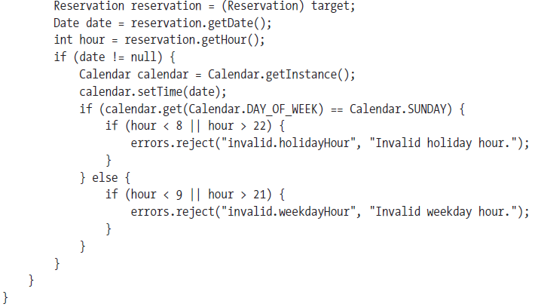
In this validator, you use utility methods such as rejectIfEmptyOrWhitespace() and rejectIfEmpty() in the ValidationUtils class to validate the required form fields. If any of these formfields is empty, these methods will create a field error that will be bound to the
field. The second argument of these methods is the property name, while the third and fourth are the error code and default error message.

Slide 80
<bean id="reservationFormController"
class="com.training.court.web.ReservationFormController">
...
<property name="validator">
<bean class="com.training.court.domain.ReservationValidator" />
</property>
</bean>
As your validators may create errors during validation, you should define messages for
the error codes for displaying to the user. If you have ResourceBundleMessageSource defined, you can include the following error messages in your resource bundle for the appropriate locale (e.g., messages.properties for the default locale):
required.courtName=Court name is required
required.date=Date is required
required.hour=Hour is required
required.playerName=Player name is required
required.sportType=Sport type is required
invalid.holidayHour=Invalid holiday hour

Slide 81
Validating with Commons Validator
Spring Modules provides an implementation of Validator called DefaultBeanValidator. DefaultBeanValidator can be configured as follows :
  <bean id="beanValidator" class=
  "org.springmodules.commons.validator.DefaultBeanValidator">
  <property name="validatorFactory" ref="validatorFactory" />
  </bean>
DefaultBeanValidator doesn’t do any actual validation work. Instead, it delegates to Commons Validator to validate field values.

Slide 82
As you can see, DefaultBeanValidator has a validatorFactory property that is wired with a reference to a validatorFactory bean. The validatorFactory bean is declared using the following XML:
  <bean id="validatorFactory" class=
  "org.springmodules.commons.validator.DefaultValidatorFactory">
    <property name="validationConfigLocations">
      <list>
      <value>WEB-INF/validator-rules.xml</value>
      <value>WEB-INF/validation.xml</value>
      </list>
    </property>
  </bean>
DefaultValidatorFactory is a class that loads the Commons Validator configuration on behalf of DefaultBeanValidator. The validationConfigLocations property takes a list of one or more validation configurations. Here we’ve asked it to load two configurations: validator-rules.xml and validation.xml.

Slide 83
.Grouping Multiple Actions into a Controller
The MultiActionController class provided by Spring MVC allows you to group multiple related actions into a single controller. Your controller can extend MultiActionController and include multiple handler methods to handle multiple actions.
In a multi-action controller, you can define one or more handler methods of the following form:
public (ModelAndView | Map | String | void) actionName(
HttpServletRequest, HttpServletResponse [,HttpSession] [,CommandObject]);

Slide 84
Mapping methods
When a request is mapped to a multi-action controller by handler mappings, it has to be narrowed down to a particular handler method within the controller. MultiActionController allows you to configure method mappings with a MethodNameResolver object.
See the example 52SpringMvcUsingMultiActionController .
By default, MultiActionController maps URLs to handler methods by the method names.
For the controller in example, the URLs will be mapped to the following methods:
/member/add.htm → add()
/member/remove.htm →remove()
/member/list.htm → list()

Slide 85
Mapping URLs to Handler Methods
By default, MultiActionController uses InternalPathMethodNameResolver to map URLs to
handler methods by the method names. However, if you want to add a prefix or a suffix to the mapped method names, you have to configure this resolver explicitly:
<bean id="memberController"
class="com.training.web.MemberController">
...
<property name="methodNameResolver">
<bean class="org.springframework.web.servlet.mvc.multiaction.
InternalPathMethodNameResolver">
<property name="suffix" value="Member" />
</bean>
</property>
</bean>

Slide 86
Then the last path of a URL before the extension will be mapped to a handler method by adding Member as the suffix:
/member/add.htm → addMember()
/member/remove.htm → removeMember()
/member/list.htm →listMember()

Slide 87
Alternatively, you can configure PropertiesMethodNameResolver to map URLs to handler methods by specifying the mapping definition explicitly:
<bean id="memberController"
class="com.training.web.MemberController">
...
<property name="methodNameResolver">
<bean class="org.springframework.web.servlet.mvc.multiaction.
PropertiesMethodNameResolver">
<property name="mappings">
<props>
<prop key="/member/add.htm">addMember</prop>
<prop key="/member/remove.htm">removeMember</prop>
<prop key="/member/list.htm">listMember</prop>
</props>
</property>
</bean>
</property>
</bean>

